Slide 1
Smart Canteen Payment System
SCPS
SCPS

Slide 2
Table of Contents
Introduction
Problem Statements
Project Objectives
Literature Review
Methodology & Design
System Implementation & Features
Challenges & Risk Analysis
Conclusion & Future Scope

Slide 3

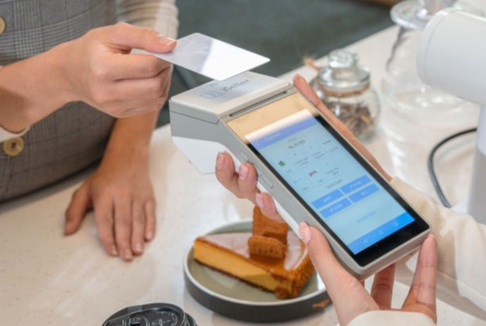
Introduction
Traditional canteen management systems rely on
manual operations, which leads to inefficiencies
like delayed order processing and billing errors.
Recent advancements in the Internet of Things (IoT)
and web applications provide a unique opportunity
to automate and streamline these processes.

Slide 4
Problem Statements
Slow order processing and payment handling.
Limited visibility into real-time sales and inventory data.
Difficulty in accurately tracking and auditing financial transactions.

Slide 5
Project Objectives
To design and implement a web-based interface for placing and managing orders.
To enable NFC-based payment processing linked to student ID cards.
To develop a visual dashboard to monitor real-time sales and send automated email notifications to stakeholders.

Slide 6
Literature Review
Online Canteen Management System
Web-based e-menu for easy access to food options.
Online payment integration streamlining order processing.
Real-time notifications to kitchen staff for immediate order updates.
Limited scalability for large institutions.
Lacks parental notifications and multi-factor authentication for added security.

Slide 7
Literature Review
2) Cashless & Online QR-Code-Based Canteen System
QR-code-based contactless ordering for a seamless user experience.
UPI and e-wallet payment options enhance convenience.
SMS notifications provide real-time order updates.
Relies heavily on QR-code technology, which can be unreliable if codes are damaged.
Scalability issues when handling high user volumes.

Slide 8
Literature Review
3) Cashless Canteen Management System
RFID-based cashless payments simplify transactions.
Encrypted payment processing ensures secure operations.
Real-time order display in the kitchen improves workflow efficiency.
Susceptible to operational issues from lost or damaged RFID cards.
Lacks multi-device support, parental notifications, and comprehensive reporting tools.

Slide 9
Literature Review
4) Comprehensive Web-Based Canteen Food Ordering System
Scalable web-based platform for managing high transaction volumes.
Real-time inventory updates streamline stock management.
Centralized admin dashboard for efficient monitoring and reporting.
Requires advanced infrastructure, which may not be feasible for smaller canteens.
Lacks multi-factor authentication and does not provide parental notification features.

Slide 10
Literature Review
5) Food Ordering System with Data Analytics
QR-code-based ordering for a contactless dining experience.
Automated billing to reduce human error.
Data analytics integration for visualized insights on sales and customer behavior.
Machine learning for demand forecasting and strategic decision-making.
Requires a reliable internet connection and mobile devices for all users.
High initial setup cost due to the integration of data analytics and machine learning.
Potential learning curve for restaurant staff to fully utilize the analytics dashboard and forecasting features.

Slide 11
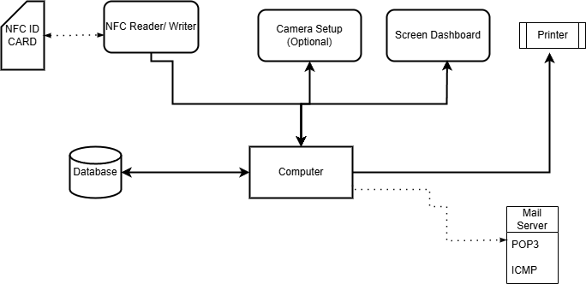
Methodology & Design
System Architecture

Slide 12
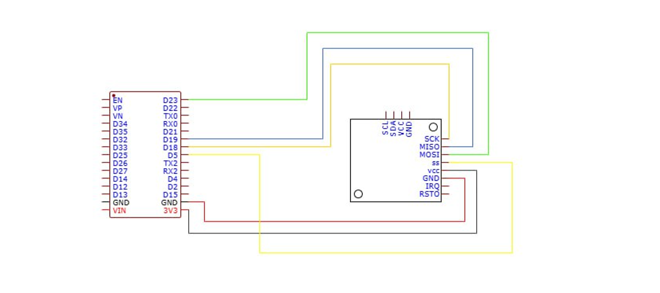
Methodology & Design
Hardware Component And Design

Slide 13
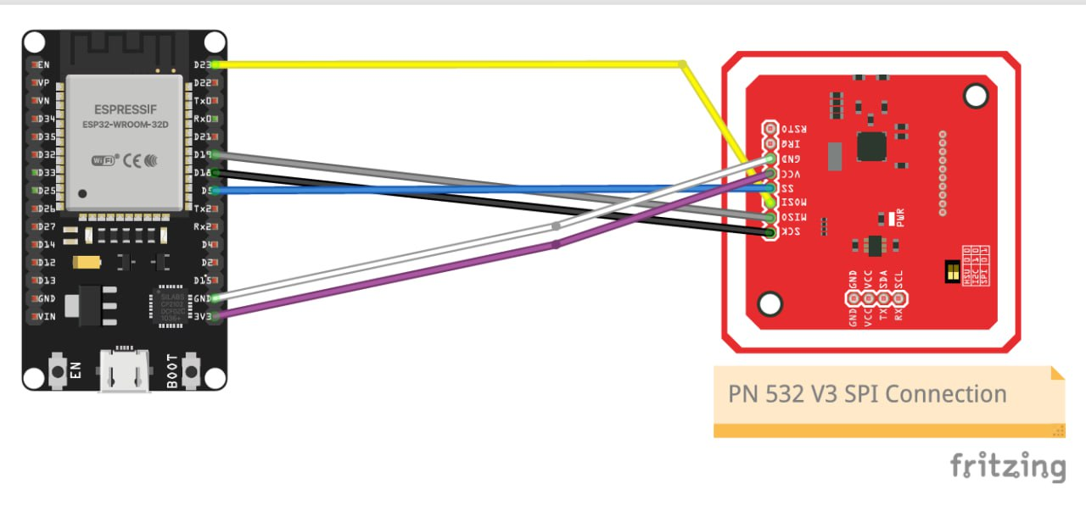
Methodology & Design
Fritzing Diagram (Hardware)

Slide 14
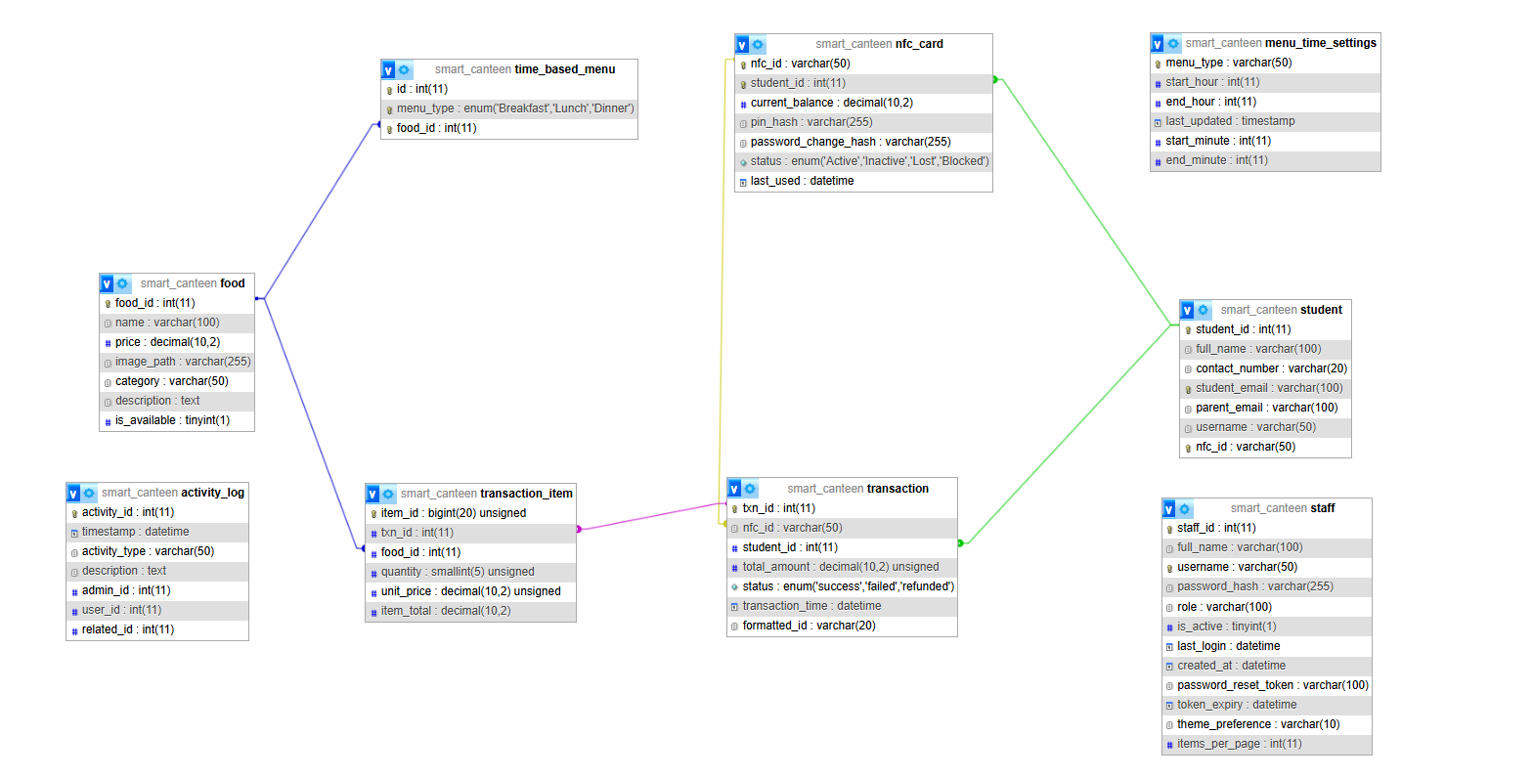
Methodology & Design
Database Design

Slide 15






Methodology & Design
Technology & Stacks
Frontend
Backend
Database

Slide 16
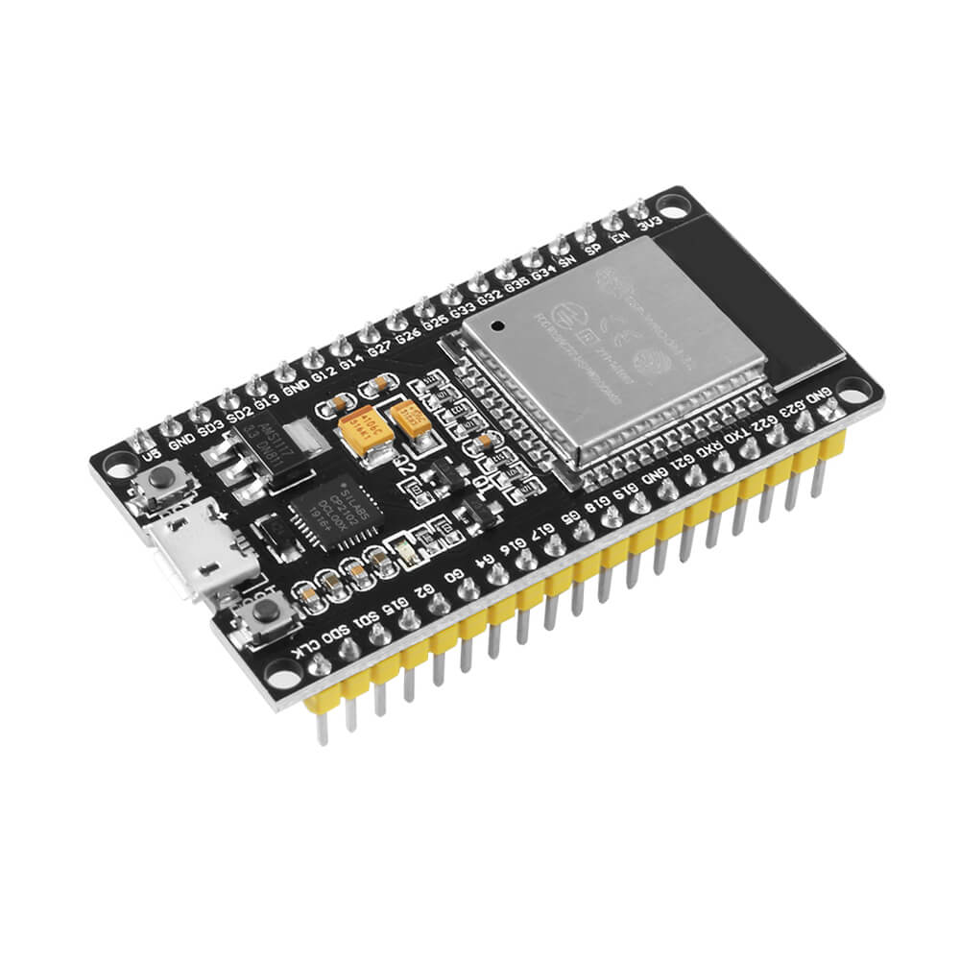
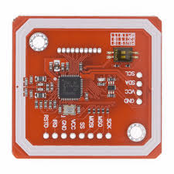
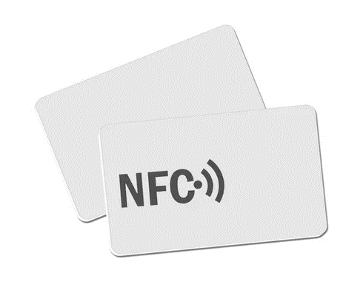



Methodology & Design
Technology & Stacks
Hardware
Design Tools

Slide 17
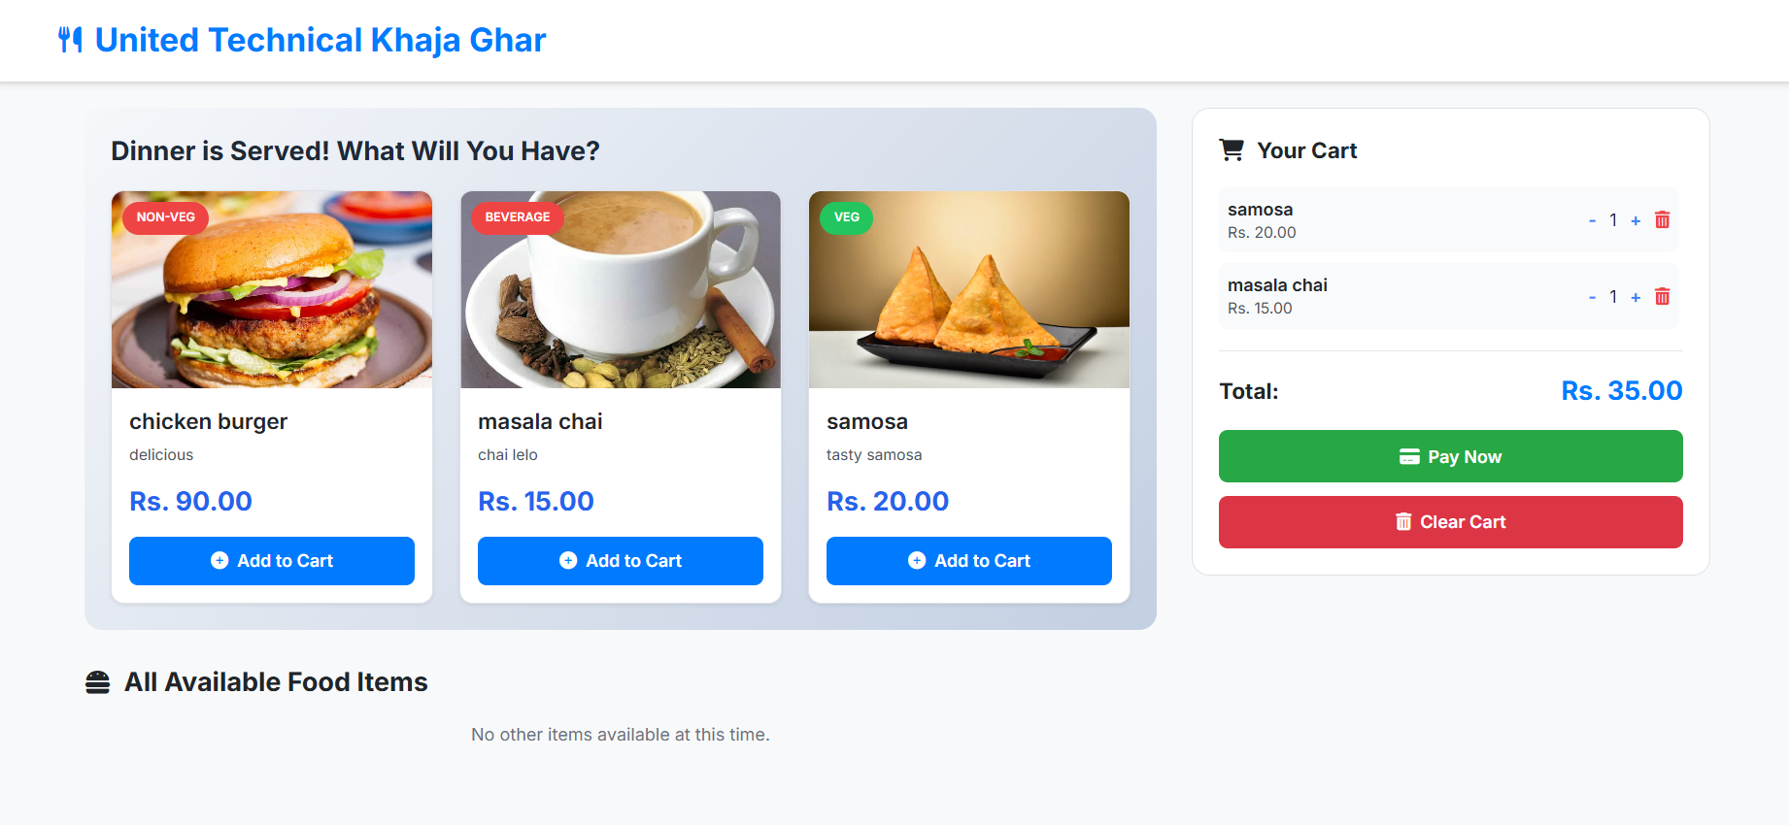
System Implementation & Features
Ordering Page

Slide 18
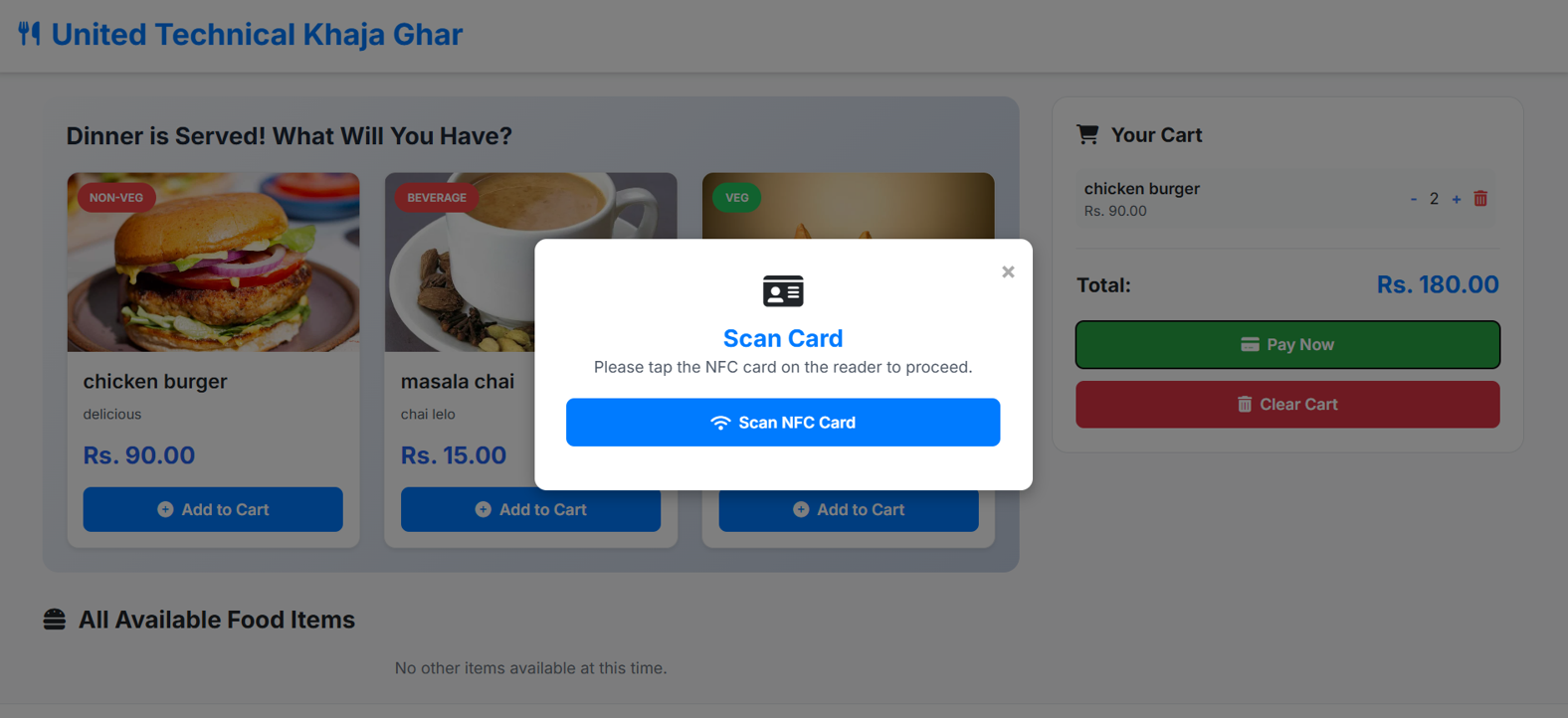
System Implementation & Features
Payment Process

Slide 19
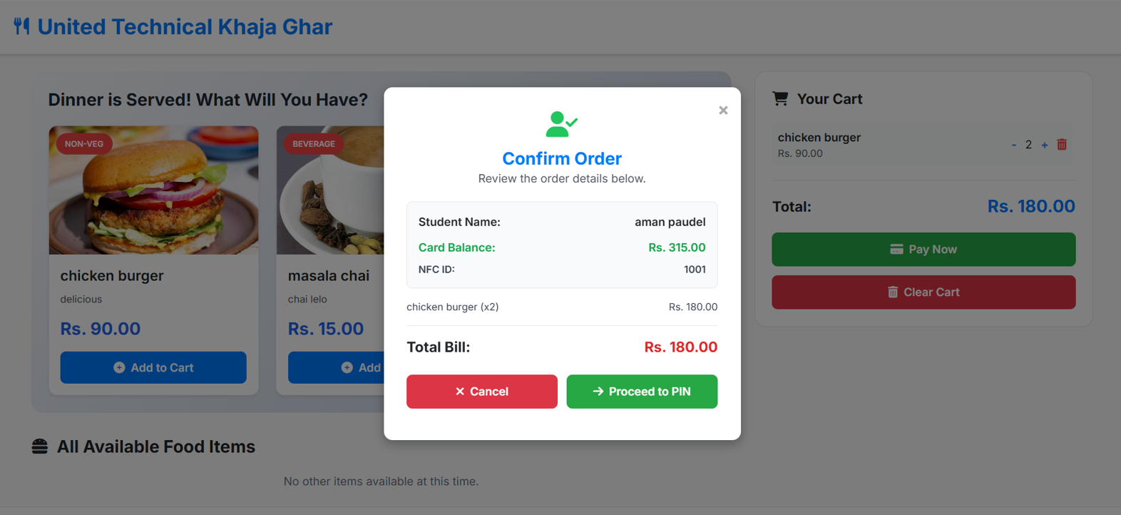
System Implementation & Features
Payment Process

Slide 20
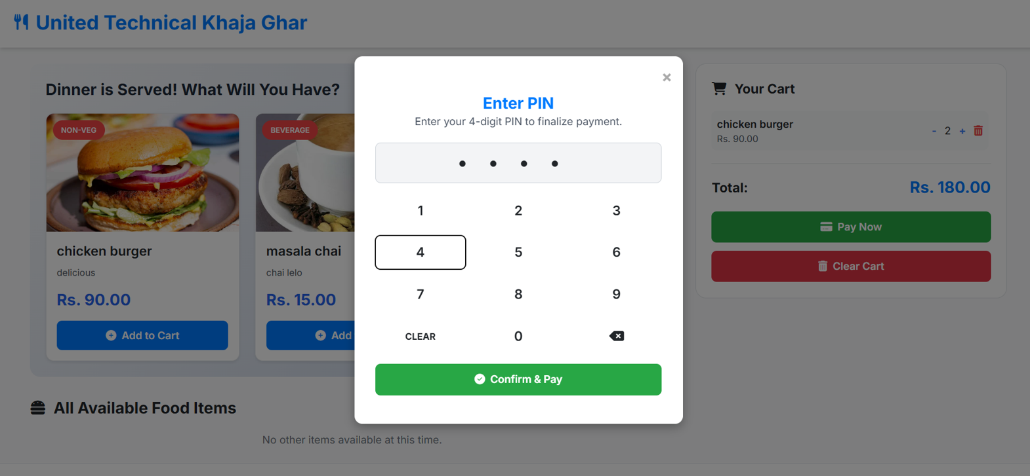
System Implementation & Features
Payment Process

Slide 21
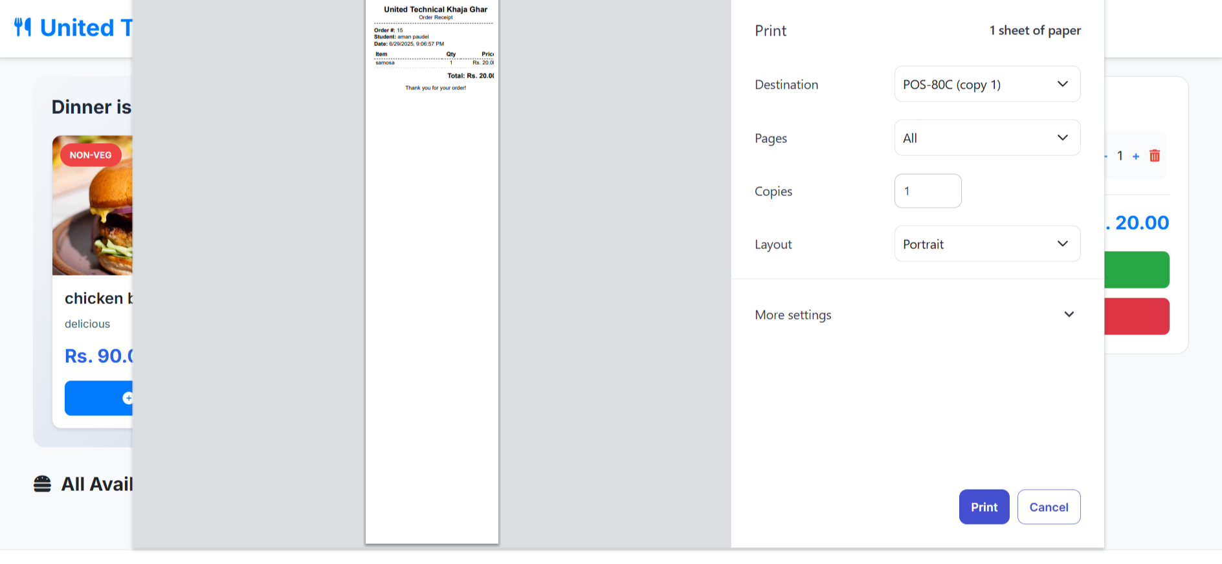
System Implementation & Features
Receipt Print

Slide 22
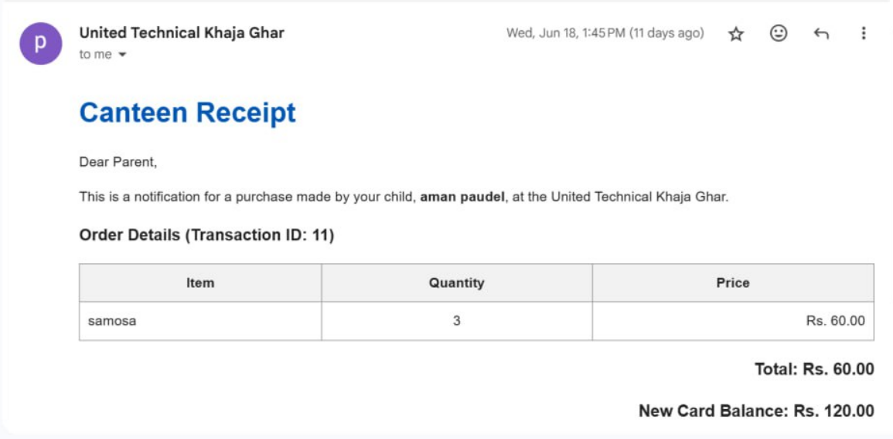
System Implementation & Features
Email Notification

Slide 23
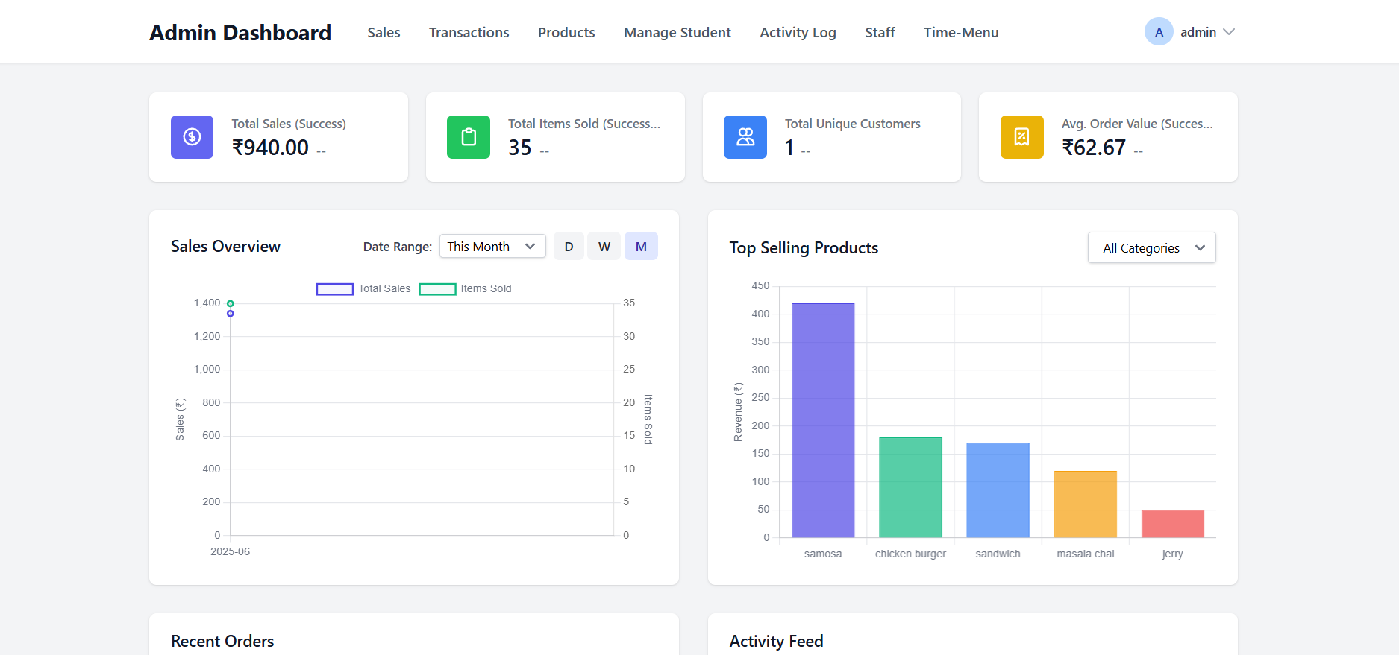
System Implementation & Features
Admin Dashboard

Slide 24
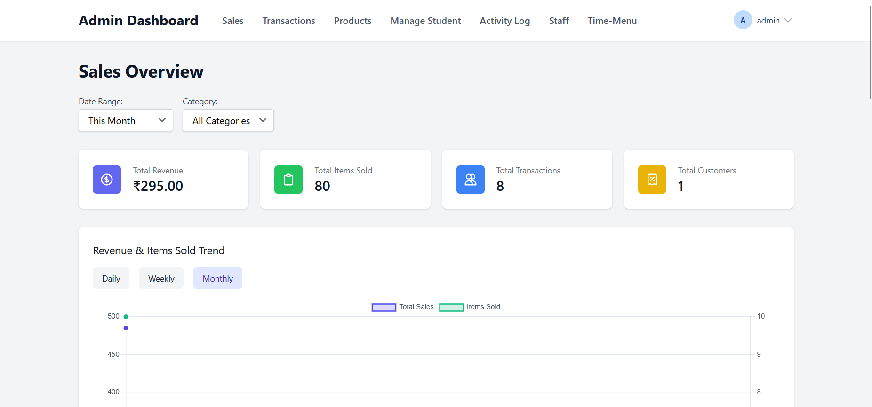
System Implementation & Features
Admin Dashboard
Sales

Slide 25
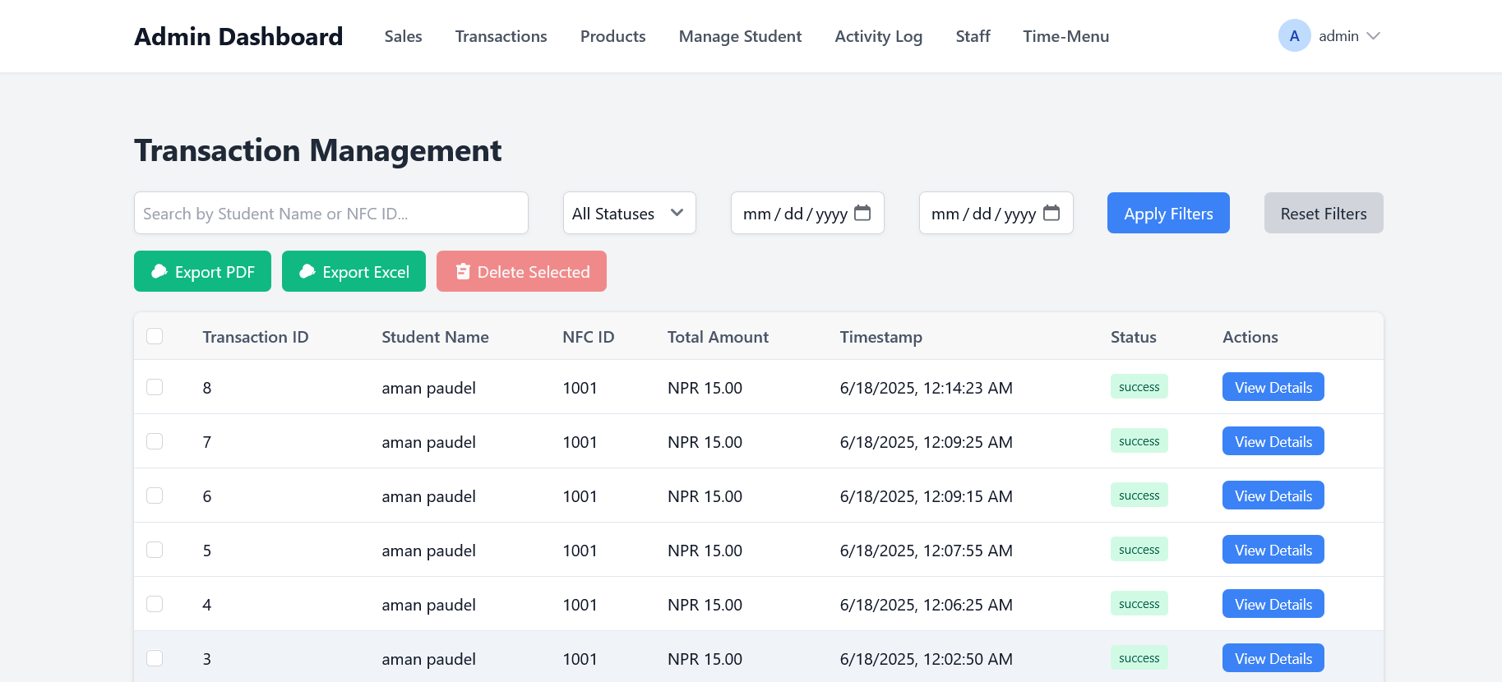
System Implementation & Features
Admin Dashboard
Transactions

Slide 26
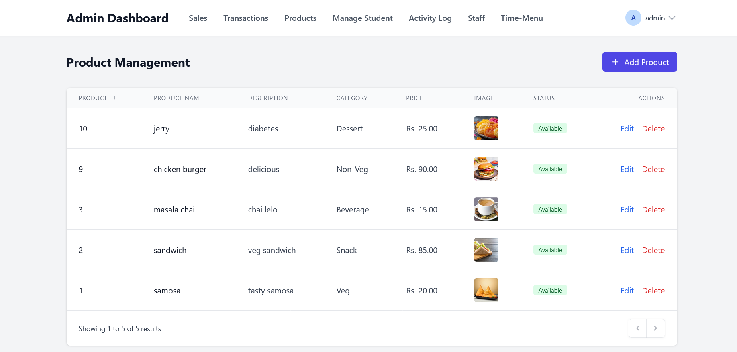
System Implementation & Features
Admin Dashboard
Products

Slide 27
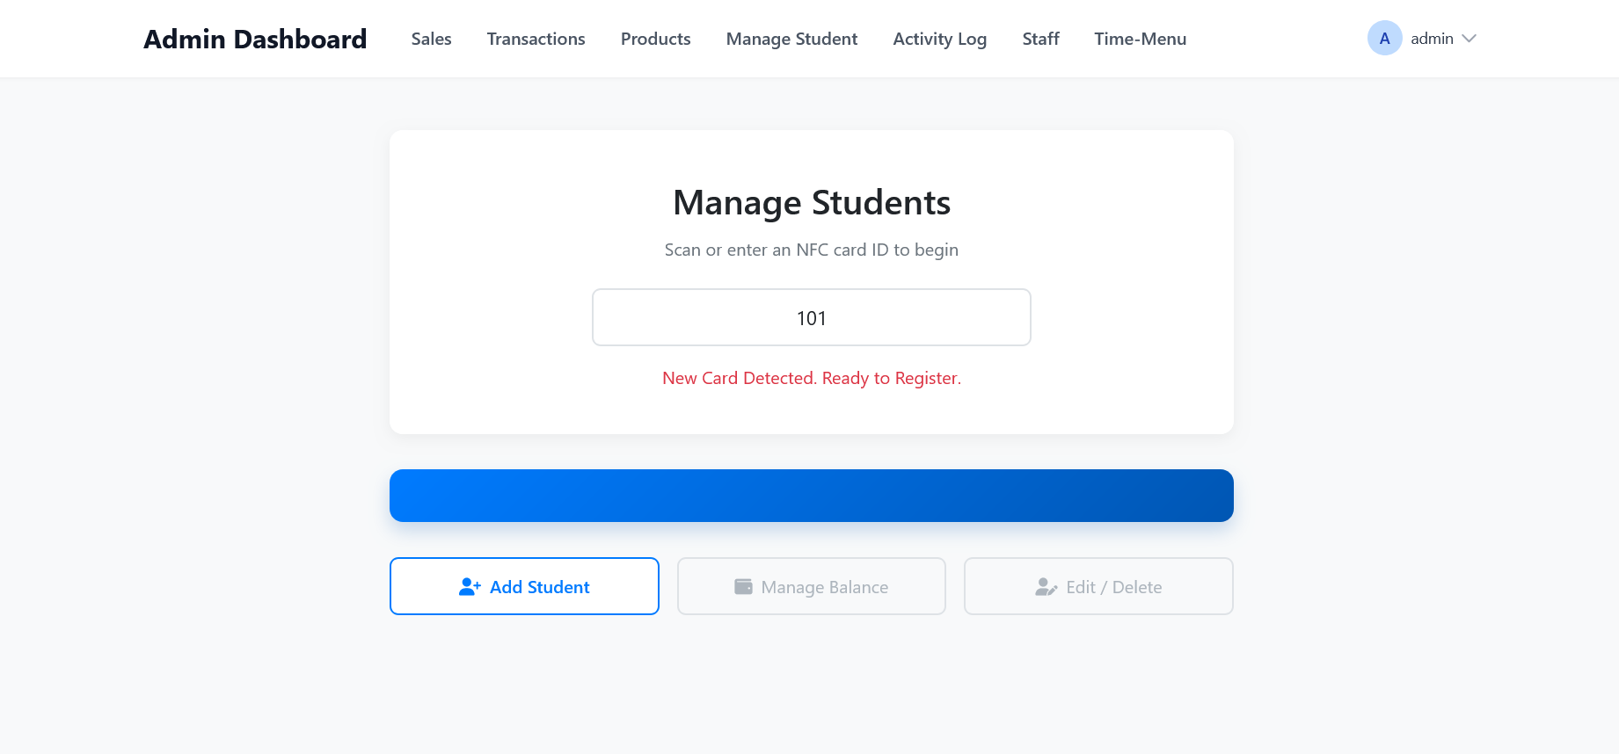
System Implementation & Features
Admin Dashboard
Manage Students

Slide 28
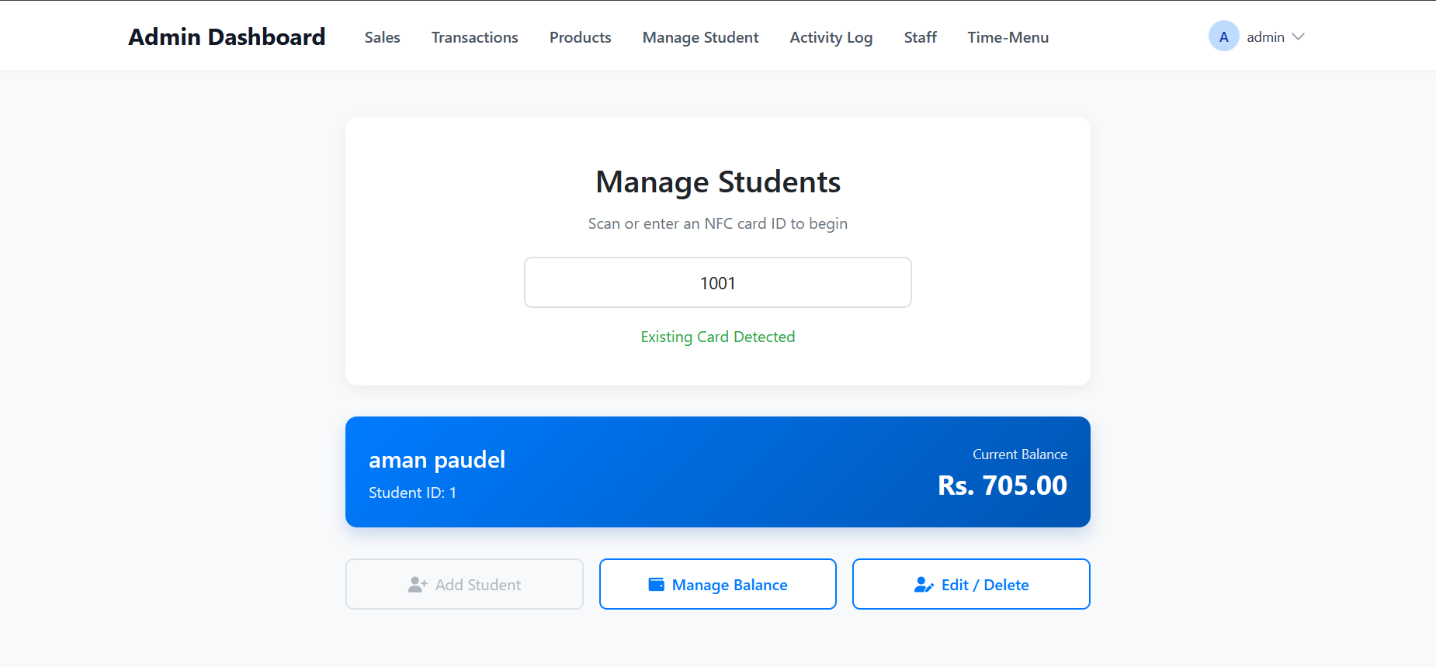
System Implementation & Features
Admin Dashboard
Manage Students

Slide 29
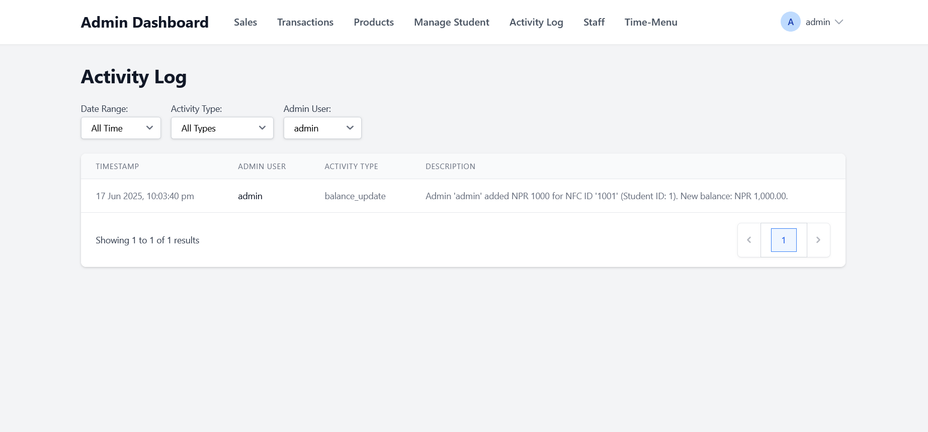
System Implementation & Features
Admin Dashboard
Activity Log

Slide 30
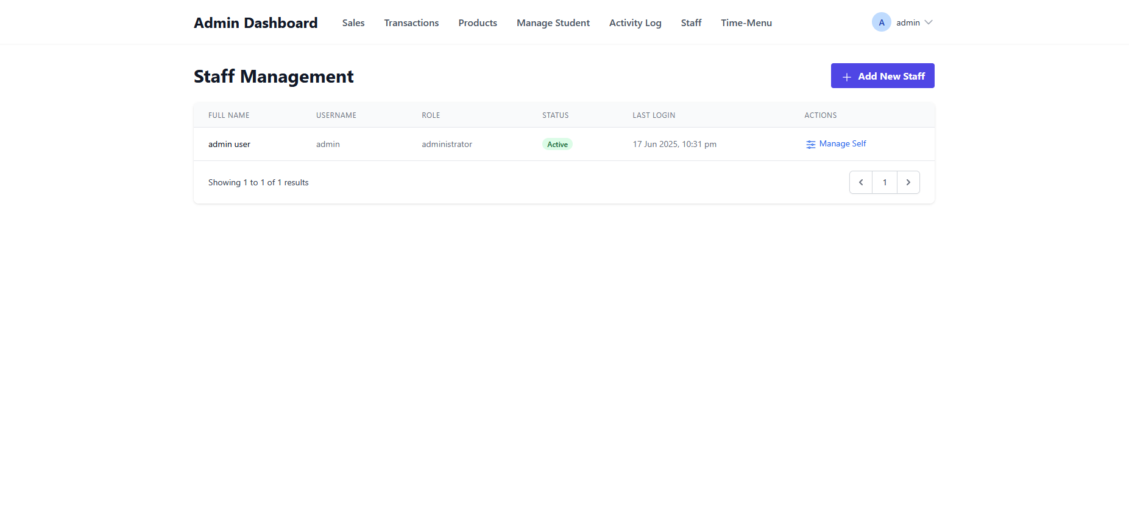
System Implementation & Features
Admin Dashboard
Staff

Slide 31
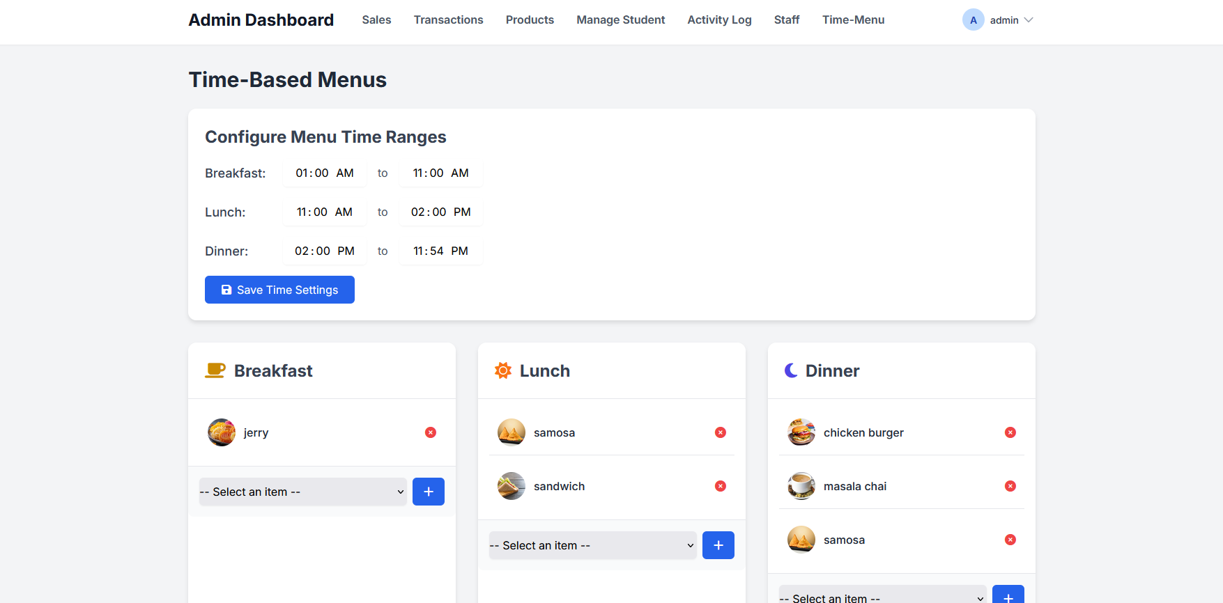
System Implementation & Features
Admin Dashboard
Time-Menu

Slide 32
Challenges & Risk Analysis
Challenges
Hardware Communication Issues
Power & Wiring Constraints
Real-time Sync and Data Accuracy

Slide 33
Challenges & Risk Analysis
Risk Mitigation Strategies
Implemented retry and debounce logic on ESP32 reads
Separated power sources for stability
Introduced local logging in ESP32 as backup
Validated backend endpoints using mock data
Scheduled regular testing checkpoints to verify system integrity
SPI Based connection was more stable and reliable for communication

Slide 34
Future Scope
Cloud-Based Deployment For Scalability
Extending NFC Applications Beyond Canteen
Enhancing Security With Biometric Verification
Leveraging AI & Machine Learning

Slide 35




Our Team
Aman Paudel
Raj Gurung
Rozal Dahal
Prajjwal Adhikari

Slide 36
THANK YOU

